Slide 1

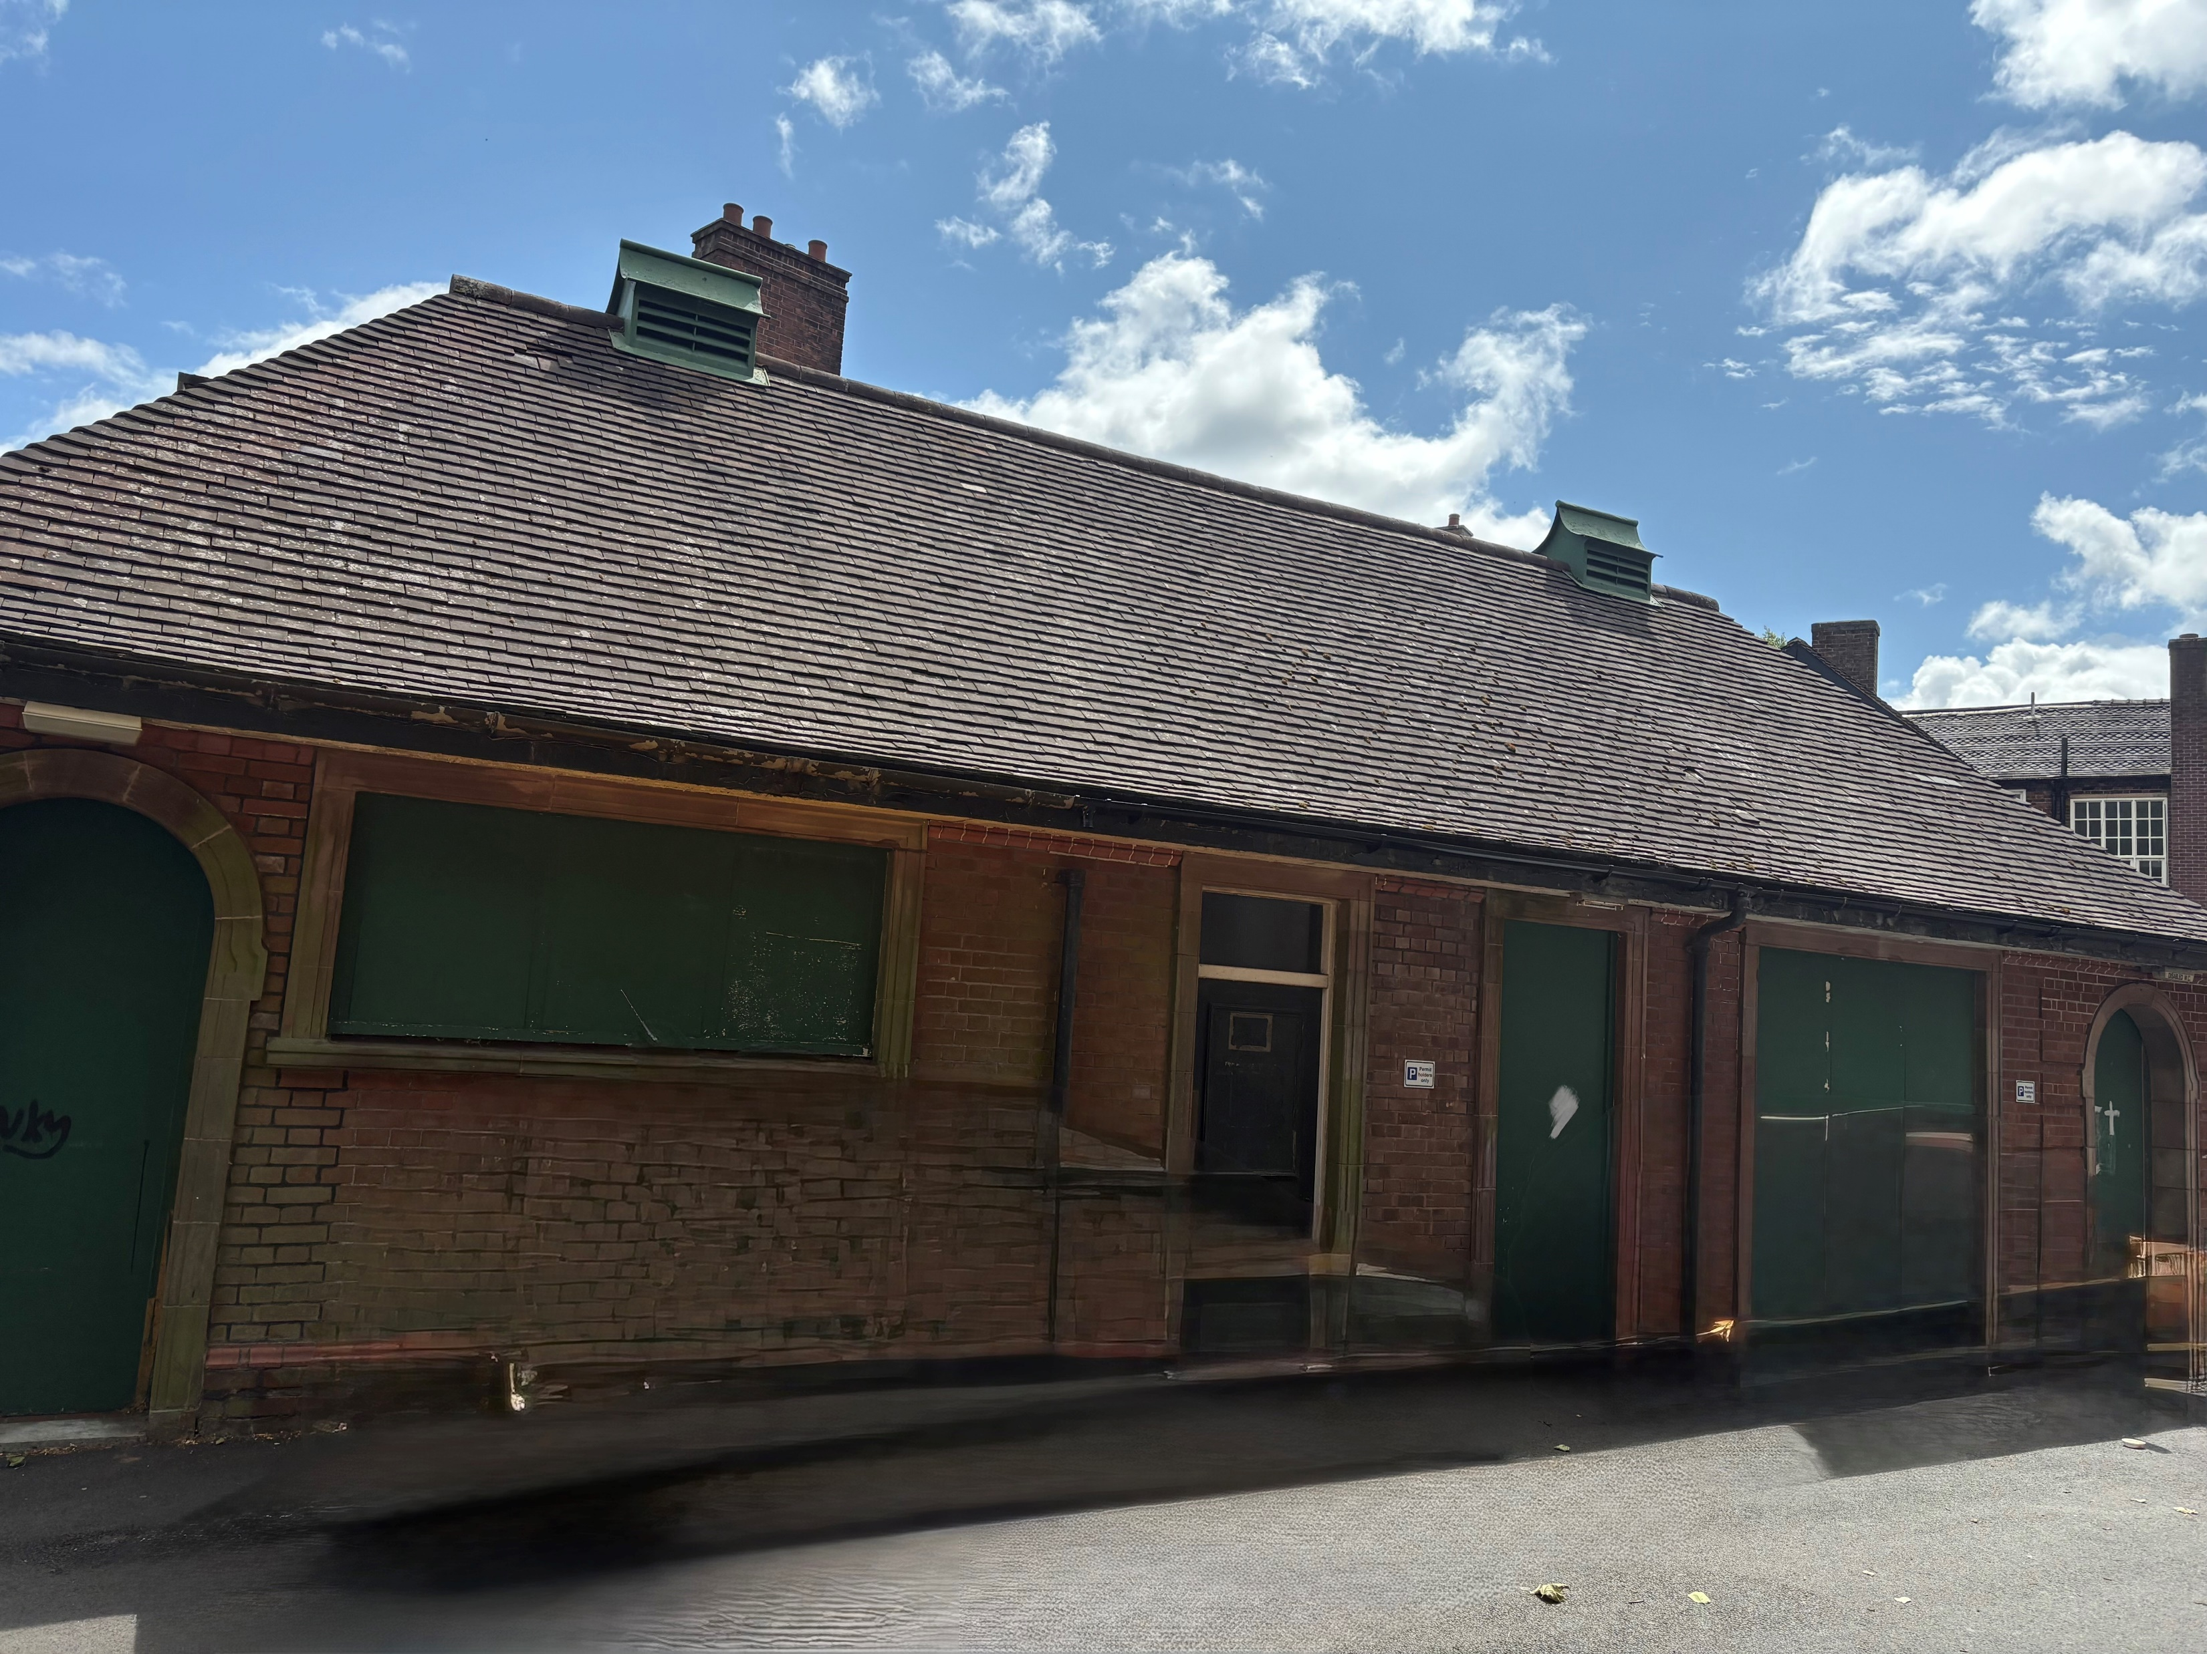
FOR SALE OFFERS INVITED
Via Sealed Bids BY CLOSING DATE – 12 NOON 30.09.2025
Former Public Conveniences
Merrial Street, Newcastle Under Lyme, Staffordshire ST5 2AE
Contact Chloe Langford: chloe.langford@newcastle-staffs.gov.uk

Slide 2

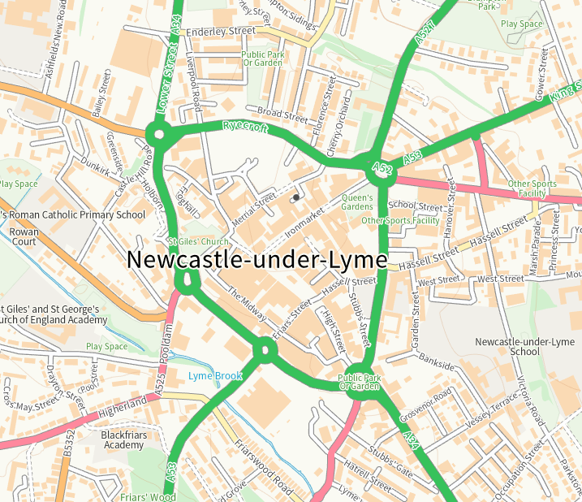

Former Public Conveniences
Merrial Street, Newcastle under Lyme, ST5 2AE
Location
The property is located in Newcastle-Under-Lyme town centre, the site is situated on the street linking the Iron Market to Merrial Street making up part of the town centre’s conservation area. Sitting close to Newcastle under Lyme Borough Council’s office Castle House and the Queens Gardens. Newcastle town centre is home to a variety of national and individual operators including Boots, Coffee House and Capello Lounge. There are a number of new and exciting developments within close proximity to the site at Rye Park and Astley Place . The site is adjacent to the A52 leading on to the main A34 dual carriage way that feeds into the A500 taking you through North Staffordshire linking into J15 & 16 of the M6 motorway.
Description
This Victorian property is a former public convenience of a brick construction with timber frame windows and doors and a pitched tile clay roof.
These toilets are now closed to the public and would be suitable to a range of different uses (Subject To Planning).
Interested parties are invited to submit offers using an online pro-forma.
NB- it will be a contractual condition of the sale that the building cannot be demolished and will not be permitted for car parking.

Slide 3

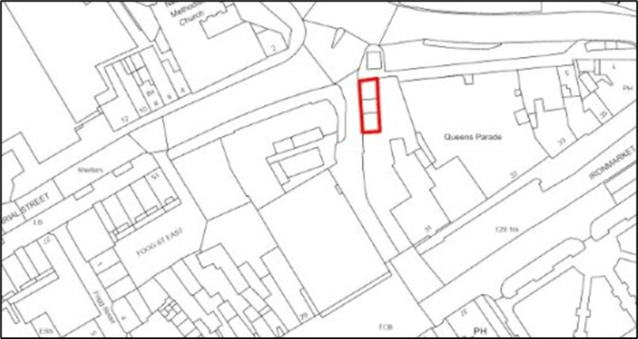
Brief Details
Accommodation
EPC – To Follow
Rating Assessment
No payment is required at present due to Lavatory Relief but will be charged once property is redeveloped.
Planning
Interested parties are to make their own enquiries of the Local Planning Authority. Any successful purchaser will be liable to seek their own planning permission.
Note - This property is located within a conservation area and on the Local List therefore the property must be retained.
Services
Interested parties are advised to make their own investigations to satisfy themselves of their suitability.
Car Parking
This site does not have access to car parking.
Redevelopment opportunity Newcastle Under Lyme town centre.
Total Site area: Approx 576.01 Sq. Ft/ 53.513 Sq. M.
For Sale Freehold with vacant possession
Planning Permission to be acquired by purchaser.

Slide 4

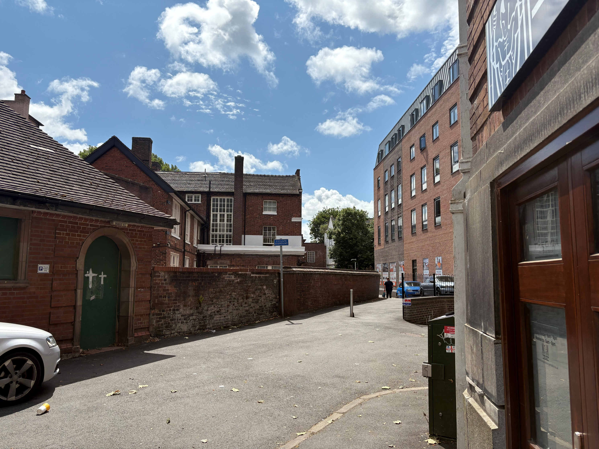
Important Advice
The Applicant is recommended to read all of the information contained within the Legal Pack.
Link: Sales Pack
Demolition
The successful applicant will not be permitted to demolish the building.
Offers are invited
Offers must be made by completion of the online pro-forma which can be accessed using the following link click here to make an offer,
All offers are subject to obtaining satisfactory planning permission. A successful offer will result in the purchaser paying 10% of the purchase price on exchange of the contracts which will be non-refundable.
Nb the closing date for the receipt of offers is noon on 30th September 2025
Receipt of an offer will be acknowledged by way of email.
NB the Council will not be bound to accept the highest or any of the offers received.
Tenure
Freehold
Legal Costs
The successful applicant is required to pay the vendors reasonable legal costs.
Viewing and Further information
By prior appointment – please call Newcastle Borough Council’s property department to arrange a viewing Tel: 01782 742373 or 01782 742375 or email propertydept@newcastle-staffs.gov.uk

Slide 5

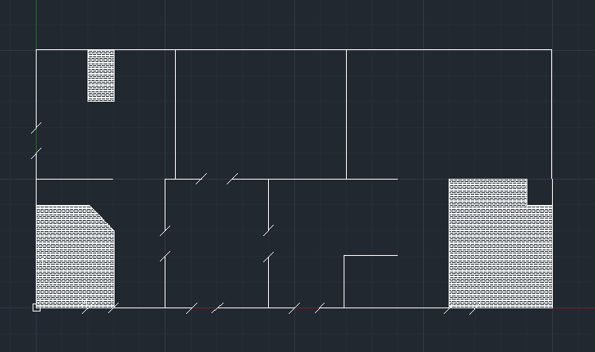
Timetable for Completion
Floor Plan (Not to Scale – For illustration purposes only )
Closing date for offers to be in by 12pm noon 30th September 2025
Applicants will be notified via email by 17:00 on 14th October 2025 of the success or otherwise their offer.
Contract of a sale are to be exchanged no later than 2nd January 2026. On exchange the purchaser is to pay 10% of the purchase price on which will be non-refundable.
The sale is to be completed within 8 weeks of successful planning permission being awarded to the purchaser or 4th January 2027 whichever is sooner.
* If you have any issues arising from this or have any other query, please telephone 01782 742373 or 01782 742375 for assistance.

